Slide 1
Computer Basics
Chapter 6 – Safety and Maintenance

Slide 2
Contents
Keeping Your Computer Clean
Protecting Your Computer
Creating a Safe Workspace
Basic Troubleshooting Techniques

Slide 3
Safety and Maintenance
Keeping your computer clean

Slide 4
Keeping your computer clean
Dust can potentially damage or even destroy parts of your computer. Cleaning your computer regularly will help you keep it working properly and avoid expensive repairs.

Slide 5
Keeping your computer clean

Slide 6
Cleaning the keyboard
Dust, food, liquid, and other particles can get stuck underneath the keys on your keyboard, which can prevent it from working properly. The basic cleaning tips below can help keep your keyboard clean.
Unplug the keyboard.
Turn the keyboard upside down and gently shake it to remove dirt and dust.
Use a can of compressed air to clean between the keys.
Moisten a cotton cloth or paper towel with rubbing alcohol and use it to clean the tops of the keys. Do not pour alcohol or any other liquid directly onto the keys.
Reconnect the keyboard to the computer once it is dry.

Slide 7
Cleaning the keyboard
If you spill liquid on the keyboard, quickly shut down the computer and disconnect the keyboard. Then turn the keyboard upside down and allow the liquid to drain.
If the liquid is sticky, you will need to hold the keyboard on its side under running water to rinse away the sticky liquid. Then turn the keyboard upside down to drain for two days before reconnecting it. Please note that keyboard may not be fixable at this point, but the method above is probably the best option.

Slide 8
Cleaning the mouse
Optical mice require no internal cleaning because they do not contain any rotating parts; however, they can get sticky over time as dust collects near the light emitter. This can cause erratic cursor movement or prevent the mouse from working properly.

Slide 9
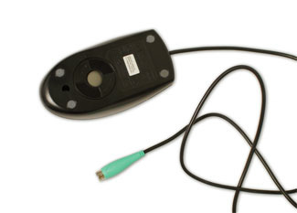
Cleaning the mouse
Mechanical mice are especially susceptible to dust and particles that can accumulate inside the mouse, which can make it difficult to track—or move—properly. If the mouse pointer does not move smoothly, the mouse may need to be cleaned.

Slide 10
Cleaning the monitor
Dirt, fingerprints, and dust can make your computer screen difficult to read; however, it's easy to clean your screen when needed. There are monitor-cleaning kits you can buy, but they may damage your monitor if they're designed for a different type of monitor. For example, a monitor cleaner that is designed for glass screens may not work with some non-glass LCD screens. The safest method is simply to use a soft clean cloth moistened with water.
Do not spray any liquids directly onto the screen. The liquid could leak into the monitor and damage the internal components.
Do not use glass cleaner to clean a monitor. Many screens have anti-glare coatings that can be damaged by glass cleaner.

Slide 11
Keep it cool
Don't restrict airflow around your computer. A computer can generate a lot of heat, so the casing has fans that keep it from overheating. Avoid stacking papers, books, and other items around your computer.
Many computer desks have an enclosed compartment for the computer case. If you have this type of desk, you may want to position the case so it is not against the back side of the desk. If the compartment has a door, you may want to leave it open to improve airflow.

Slide 12
Safety and Maintenance
Protecting your computer

Slide 13
Protecting your computer
Your computer faces many potential threats, including viruses, malware, and hard drive failure. This is why it's important to do everything you can to protect your computer and your files.

Slide 14
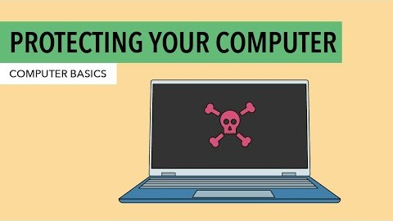
Protecting your computer

Slide 15
Safeguarding against malware
Malware is any type of software that is designed to damage your computer or gain unauthorized access to your personal information. It includes viruses, worms, Trojan horses, and spyware. Most malware is distributed over the Internet and is often bundled with other software.

Slide 16
Safeguarding against malware
The best way to guard against malware is to install antivirus software, such as Bitdefender, Norton, or Kaspersky. Antivirus software helps to prevent malware from being installed, and it can also remove malware from your computer.
It's also important to stay smart when you're browsing the Web or using email. If a website or email attachment looks suspicious, trust your instincts. Keep in mind that your antivirus program may not catch everything, so it's best to avoid downloading anything that might contain malware.

Slide 17
Backing up your computer
Imagine what would happen if your computer suddenly stopped working. Would you lose any important documents, photos, or other files? It may be possible to repair your computer, but your files may be lost forever. Luckily, you can prevent this by creating backup copies of all of your files (or just the important ones) on an external hard drive or an online backup service.

Slide 18
Backing up your computer
External hard drives
You can purchase an external hard drive and copy the contents of your computer to it. The initial backup could take several hours, so you will need to select a period of time when you do not need access to your computer. Running the backup overnight usually works best. Follow-up backups should be conducted on a regular basis, but they should not take as long.
One drawback is that an external hard drive can be lost, damaged, or stolen—just as your computer might be. This is why it's important to keep your drive in a secure location when not in use.

Slide 19
Backing up your computer
Online backup services
You can also back up your files to an online backup service like Mozy, Carbonite, or Box. These services will back up your files in the cloud, which means you'll be able to recover them from any computer with an Internet connection. The amount of storage provided by these sites varies, and you will probably need to pay a fee for adequate storage space.
One drawback to online backup services is that the initial backup can be slow and may even take days to upload if you have a lot of files. However, subsequent backups should not take as long.

Slide 20
Other maintenance techniques
To keep your computer running smoothly, it's important to keep files and folders uncluttered. Cluttered or unorganized folders make it more difficult to find the files you need. Additionally, unwanted files can eventually fill up your hard drive, which will make your computer slower and more difficult to use. Here are a few things you can do to delete unwanted files and improve your computer's performance.

Slide 21
Other maintenance techniques
Delete files: If you have any unwanted files, you can delete them manually. To do this, drag them to the Recycle Bin or Trash, then empty it to permanently delete the files.
Run the Disk Defragmenter: Windows includes a Disk Defragmenter program in the Control Panel. If your computer is running slowly, running Disk Defragmenter can help to speed it up.
Run a Disk Cleanup: Windows also includes a Disk Cleanup program in the Control Panel. It scans your computer for temporary files and other files that can be deleted. You can then delete the files to free up space on your hard drive.

Slide 22
Safety and Maintenance
Creating a safe workspace

Slide 23
Creating a safe workspace
In addition to keeping your computer healthy, it's important to think about your own health. Using a computer involves a lot of repetitive motions such as typing and using the mouse. Over time, these motions can begin to negatively impact your body, especially your wrists, neck, and back. Staring at a monitor for long periods of time can also cause eye strain. To minimize these risks, you should take a few moments to make sure your workspace is arranged in a comfortable and healthy way.

Slide 24
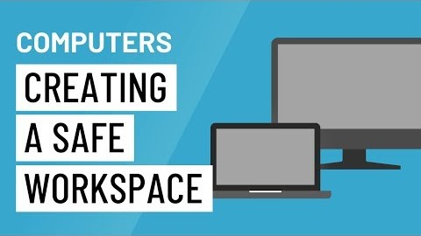
Creating a safe workspace

Slide 25
Avoiding strain and injury
Computer ergonomics is the science of equipment design and how specific equipment usage and placement can reduce a user's discomfort and increase productivity. Some equipment is designed with special attention to ergonomics, like ergonomic keyboards and ergonomic chairs.
Here are a few tips to help you avoid injury in your workspace.

Slide 26
Avoiding strain and injury
Adjust your chair: Make sure your chair is adjusted to allow you to sit in a natural, comfortable position. Many office chairs are specially designed to support the lower back and promote good posture.
Keep the keyboard at a comfortable height: Try to place the keyboard in a position that allows you to keep your wrists straight and relaxed to avoid wrist strain.
Keep the mouse close to the keyboard: If possible, place the mouse right next to the keyboard. If the mouse is too far away, it may be uncomfortable or awkward to reach for it.

Slide 27
Avoiding strain and injury
Place the monitor at a comfortable distance: The ideal position for a monitor is 20 to 40 inches away from your eyes. It should also be at eye level or slightly lower.
Avoid clutter: The computer area can quickly become cluttered with paper, computer accessories, and other items. By keeping this area as uncluttered as possible, you can improve your productivity and prevent strain and injury.

Slide 28
Avoiding strain and injury
Take frequent breaks: It's important to take breaks while you're working at your computer. To avoid eye strain, you should look away from the monitor every once in a while. You can also stand up and walk around to avoid sitting in the same position for long periods of time. Programs such as Workrave can automatically remind you to take breaks.

Slide 29
Safety and Maintenance
Basic Troubleshooting Techniques

Slide 30
Troubleshooting
Do you know what to do if your screen goes blank? What if you can't seem to close an application, or can't hear any sound from your speakers? Whenever you have a problem with your computer, don't panic! There are many basic troubleshooting techniques you can use to fix issues like this.

Slide 31
General tips to keep in mind
Write down your steps: Once you start troubleshooting, you may want to write down each step you take. This way, you'll be able to remember exactly what you've done and can avoid repeating the same mistakes.
Take notes about error messages: If your computer gives you an error message, be sure to write down as much information as possible. You may be able to use this information later to find out if other people are having the same error.
Always check the cables: If you're having trouble with a specific piece of computer hardware, such as your monitor or keyboard, an easy first step is to check all related cables to make sure they're properly connected.
Restart the computer: When all else fails, restarting the computer is a good thing to try. This can solve a lot of basic issues you may experience with your computer.

Slide 32
Using the process of elimination
If you're having an issue with your computer, you may be able to find out what's wrong using the process of elimination. This means you'll make a list of things that could be causing the problem and then test them out one by one to eliminate them. Once you've identified the source of your computer issue, it will be easier to find a solution.

Slide 33
Using the process of elimination
Scenario:
Let's say you're trying to print out invitations for a birthday party, but the printer won't print. You have some ideas about what could be causing this, so you go through them one by one to see if you can eliminate any possible causes.

Slide 34
Using the process of elimination
First, you check the printer to see that it's turned on and plugged in to the surge protector. It is, so that's not the issue. Next, you check to make sure the printer's ink cartridge still has ink and that there is paper loaded in the paper tray. Things look good in both cases, so you know the issue has nothing to do with ink or paper.

Slide 35
Using the process of elimination
Now you want to make sure the printer and computer are communicating correctly. If you recently downloaded an update to your operating system, it might interfere with the printer. But you know there haven't been any recent updates and the printer was working yesterday, so you'll have to look elsewhere.

Slide 36
Using the process of elimination
You check the printer's USB cord and find that it's not plugged in. You must have unplugged it accidentally when you plugged something else into the computer earlier. Once you plug in the USB cord, the printer starts working again. It looks like this printer issue is solved!

Slide 37
Using the process of elimination
This is just one example of an issue you might encounter while using a computer. In the rest of this lesson, we'll talk about other common computer problems and some ways to solve them.

Slide 38
Simple solutions to common problems
Most of the time, problems can be fixed using simple troubleshooting techniques, like closing and reopening the program.
It's important to try these simple solutions before resorting to more extreme measures. If the problem still isn't fixed, you can try other troubleshooting techniques.

Slide 39
Simple solutions to common problems
Problem: Power button will not start computer
Solution 1: If your computer does not start, begin by checking the power cord to confirm that it is plugged securely into the back of the computer case and the power outlet.
Solution 2: If it is plugged into an outlet, make sure it is a working outlet. To check your outlet, you can plug in another electrical device, such as a lamp.
Solution 3: If the computer is plugged in to a surge protector, verify that it is turned on. You may have to reset the surge protector by turning it off and then back on. You can also plug a lamp or other device into the surge protector to verify that it's working correctly.
Solution 4: If you are using a laptop, the battery may not be charged. Plug the AC adapter into the wall, then try to turn on the laptop. If it still doesn't start up, you may need to wait a few minutes and try again.

Slide 40
Simple solutions to common problems
Problem: An application is running slowly
Solution 1: Close and reopen the application.
Solution 2: Update the application. To do this, click the Help menu and look for an option to check for Updates. If you don't find this option, another idea is to run an online search for application updates.

Slide 41
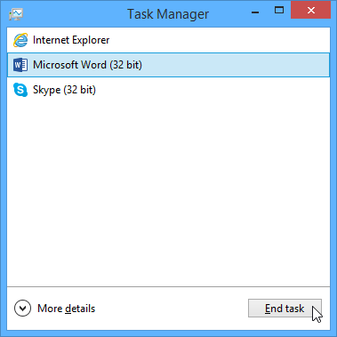
Simple solutions to common problems
Problem: An application is frozen
Solution 1: Force quit the application. On a PC, you can press (and hold) Ctrl+Alt+Delete (the Control, Alt, and Delete keys) on your keyboard to open the Task Manager. On a Mac, press and hold Command+Option+Esc. You can then select the unresponsive application and click End task (or Force Quit on a Mac) to close it.
Solution 2: Restart the computer. If you are unable to force quit an application, restarting your computer will close all open apps.

Slide 42
Simple solutions to common problems
Problem: All programs on the computer run slowly
Solution 1: Run a virus scanner. You may have malware running in the background that is slowing things down.
Solution 2: Your computer may be running out of hard drive space. Try deleting any files or programs you don't need.
Solution 3: If you're using a PC, you can run Disk Defragmenter.

Slide 43
Simple solutions to common problems
Problem: The computer is frozen
Solution 1: Restart Windows Explorer. To do this, press and hold Ctrl+Alt+Delete on your keyboard to open the Task Manager. Next, locate and select Windows Explorer from the Processes tab and click Restart. You may need to click More Details at the bottom of the window to see the Processes tab.
Solution 2: Press and hold the Power button. The Power button is usually located on the front or side of the computer, typically indicated by the power symbol. Press and hold the Power button for 5 to 10 seconds to force the computer to shut down.
Solution 3: If the computer still won't shut down, you can unplug the power cable from the electrical outlet. If you're using a laptop, you may be able to remove the battery to force the computer to turn off.

Slide 44
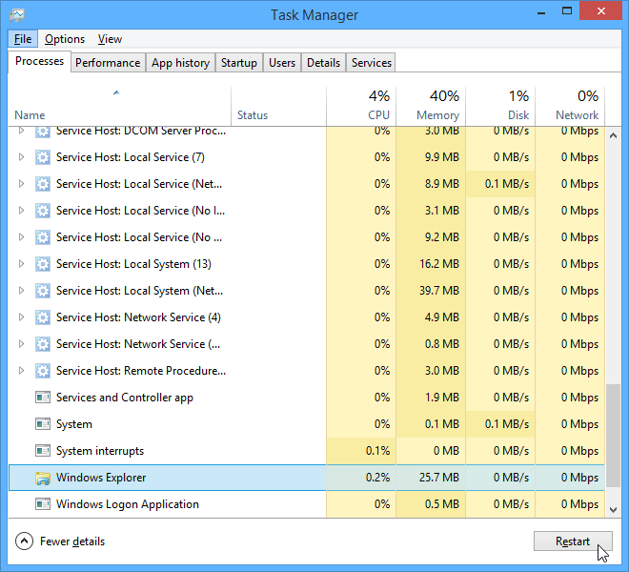
Simple solutions to common problems
Problem: The computer is frozen

Slide 45
Simple solutions to common problems
Problem: The mouse or keyboard has stopped working
Solution 1: If you're using a wired mouse or keyboard, make sure it's correctly plugged into the computer.
Solution 2: If you're using a wireless mouse or keyboard, make sure it's turned on and that its batteries are charged.

Slide 46
Simple solutions to common problems
Problem: The sound isn’t working
Solution 1: Check the volume level. Click the audio button in the top-right or bottom-right corner of the screen to make sure the sound is turned on and that the volume is up.
Solution 2: Check the audio player controls. Many audio and video players will have their own separate audio controls. Make sure the sound is turned on and that the volume is turned up in the player.
Solution 3: Check the cables. Make sure external speakers are plugged in, turned on, and connected to the correct audio port or a USB port. If your computer has color-coded ports, the audio output port will usually be green.
Solution 4: Connect headphones to the computer to find out if you can hear sound through the headphones.

Slide 47
Simple solutions to common problems
Problem: The screen is blank
Solution 1: The computer may be in Sleep mode. Click the mouse or press any key on the keyboard to wake it.
Solution 2: Make sure the monitor is plugged in and turned on.
Solution 3: Make sure the computer is plugged in and turned on.
Solution 4: If you're using a desktop, make sure the monitor cable is properly connected to the computer tower and the monitor.

Slide 48
Solving more difficult problems
If you still haven't found a solution to your problem, you may need to ask someone else for help. As an easy starting point, we'd recommend searching the Web. It's possible that other users have had similar problems, and solutions to these problems are often posted online. Also, if you have a friend or family member who knows a lot about computers, they may be able to help you.
Keep in mind that most computer problems have simple solutions, although it may take some time to find them. For difficult problems, a more drastic solution may be required, like reformatting your hard drive or reinstalling your operating system. If you think you might need a solution like this, we recommend consulting a professional first. If you're not a computer expert, it's possible that attempting these solutions could make the situation worse.

Slide 49
THE END

