Slide 1
Computer Basics
Chapter 5 – Using the Internet

Slide 2
Contents
Connecting to the Internet
Getting Started with the Internet
Understanding the Cloud

Slide 3
Connecting to the Internet
Once you've set up your computer, you may want to purchase home Internet access so you can send and receive email, browse the Web, stream videos, and more. You may even want to set up a home wireless network, commonly known as Wi-Fi, so you can connect multiple devices to the Internet at the same time.

Slide 4
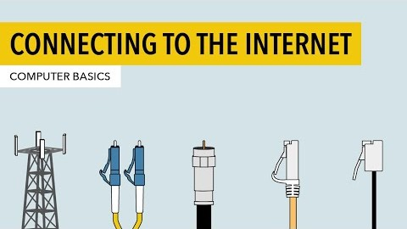
Connecting to the Internet

Slide 5
Types of Internet service
Dial-up: This is generally the slowest type of Internet connection, and you should probably avoid it unless it is the only service available in your area. Dial-up Internet uses your phone line, so unless you have multiple phone lines you will not be able to use your landline and the Internet at the same time.
DSL: DSL service uses a broadband connection, which makes it much faster than dial-up. DSL connects to the Internet via a phone line but does not require you to have a landline at home. And unlike dial-up, you'll be able to use the Internet and your phone line at the same time.
Cable: Cable service connects to the Internet via cable TV, although you do not necessarily need to have cable TV in order to get it. It uses a broadband connection and can be faster than both dial-up and DSL service; however, it is only available where cable TV is available.

Slide 6
Types of Internet service
Satellite: A satellite connection uses broadband but does not require cable or phone lines; it connects to the Internet through satellites orbiting the Earth. As a result, it can be used almost anywhere in the world, but the connection may be affected by weather patterns. Satellite connections are also usually slower than DSL or cable.
3G and 4G: 3G and 4G service is most commonly used with mobile phones, and it connects wirelessly through your ISP's network. However, these types of connections aren't always as fast as DSL or cable. They will also limit the amount of data you can use each month, which isn't the case with most broadband plans.

Slide 7
Choosing an ISP
Most ISPs offer several tiers of service with different Internet speeds, usually measured in Mbps (short for megabits per second). If you mainly want to use the Internet for email and social networking, a slower connection (around 2 to 5 Mbps) might be all you need. However, if you want to download music or stream videos, you'll want a faster connection (at least 5 Mbps or higher).
You'll also want to consider the cost of the service, including installation charges and monthly fees. Generally speaking, the faster the connection, the more expensive it will be per month.

Slide 8
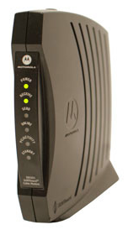
Hardware needed: Modem
Once you have your computer, you really don't need much additional hardware to connect to the Internet. The primary piece of hardware you need is a modem.
The type of Internet access you choose will determine the type of modem you need. Dial-up access uses a telephone modem, DSL service uses a DSL modem, cable access uses a cable modem, and satellite service uses a satellite adapter. Your ISP may give you a modem—often for a fee—when you sign a contract, which helps ensure that you have the right type of modem. However, if you would prefer to shop for a better or less expensive modem, you can choose to buy one separately.

Slide 9
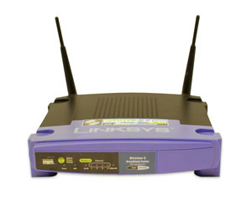
Hardware needed: Router
A router is a hardware device that allows you to connect several computers and other devices to a single Internet connection, which is known as a home network. Many routers are wireless, which allows you to create a home wireless network, commonly known as a Wi-Fi network.
You don't necessarily need to buy a router to connect to the Internet. It's possible to connect your computer directly to your modem using an Ethernet cable. Also, many modems include a built-in router, so you have the option of creating a Wi-Fi network without buying extra hardware.

Slide 10
Getting started with the Internet
The Internet is a global network of billions of computers and other electronic devices. With the Internet, it's possible to access almost any information, communicate with anyone else in the world, and much more. You can do all of this on your computer.

Slide 11
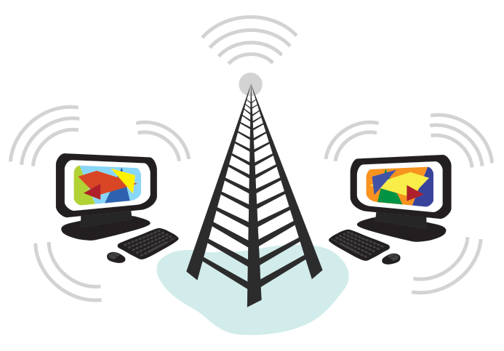
Connecting to the Internet
A device has to be connected to the Internet before you can access it. If you plan to use the Internet at home, you'll usually need to purchase an Internet connection from an Internet service provider, which will likely be a phone company, cable company, or the government. Other devices usually connect through Wi-Fi or cellular Internet connections. Sometimes libraries, cafes, and schools offer free Wi-Fi for their patrons, customers, and students.

Slide 12
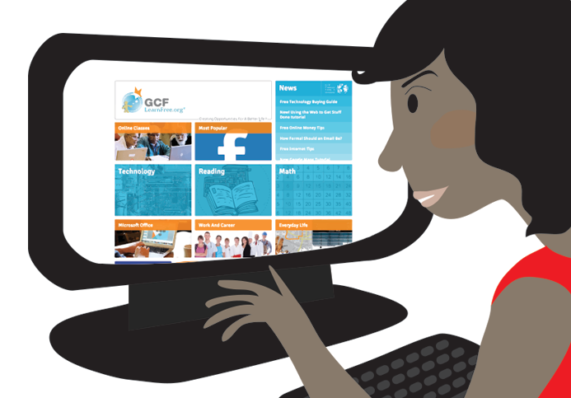
Browsing the web
Most information on the Internet is on websites. Once you are connected to the Internet, you can access websites using a kind of application called a web browser.

Slide 13
Browsing the web
A website is a collection of related text, images, and other resources. Websites can resemble other forms of media—like newspaper articles or television programs—or they can be interactive in a way that's unique to computers. The purpose of a website can be almost anything: a news platform, an advertisement, an online library, a forum for sharing images, or an educational site like us!
A web browser allows you to connect to and view websites. The web browser itself is not the Internet, but it displays pages on the Internet. Each website has a unique address. By typing this address into your web browser, you can connect to that website and your web browser will display it.

Slide 14
Navigating websites
Websites often have links to other sites, also called hyperlinks. These are often parts of the text on the website. They are usually colored blue, and sometimes they are underlined or bold. If you click the text, your browser will load a different page. Web authors use hyperlinks to connect relevant pages. This web of links is one of the most unique features of the Internet, lending to the old name World Wide Web.
Each website has a unique address, called a URL. You'll notice that when you click a link, the URL changes as your browser loads a new page. If you type a URL in the address bar in your browser, your browser will load the page associated with that URL. It's like a street address, telling your browser where to go on the Internet.

Slide 15
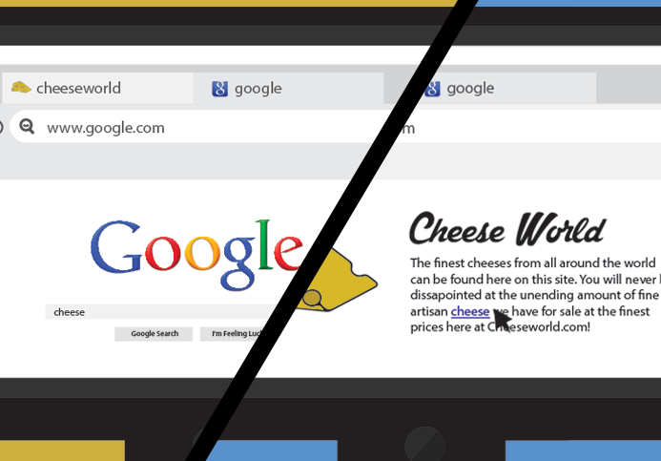
Navigating websites
When you're looking for specific information on the Internet, a search engine can help. A search engine is a specialized website that's designed to help you find other websites. If you type keywords or a phrase into a search engine, it will display a list of websites relevant to your search terms.

Slide 16
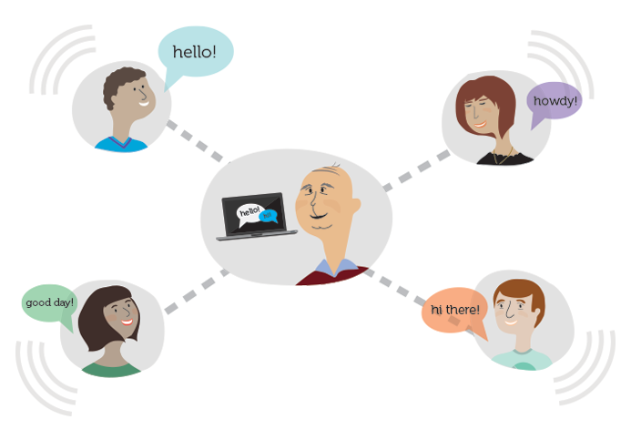
Other things you can do on the Internet
One of the best features of the Internet is the ability to communicate almost instantly with anyone in the world. Email is one of the oldest and most universal ways to communicate and share information on the Internet, and billions of people use it. Social media allows people to connect in a variety of ways and build communities online.

Slide 17
Other things you can do on the Internet
There are many other things you can do on the Internet too. There are thousands of ways to keep up with news or shop for anything online. You can pay your bills, manage your bank accounts, meet new people, watch TV, or learn new skills. You can learn or do almost anything online.

Slide 18
Understanding the Cloud
You may have heard people using terms like the cloud, cloud computing, or cloud storage. But what exactly is the cloud?
Simply put, the cloud is the Internet—more specifically, it's all of the things you can access remotely over the Internet. When something is in the cloud, it means it's stored on Internet servers instead of your computer's hard drive.

Slide 19
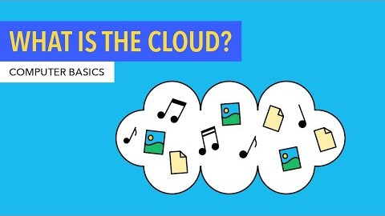
Understanding the Cloud

Slide 20
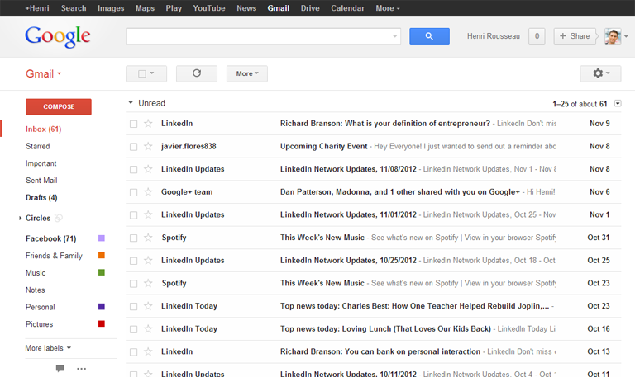
Why use the cloud?
Some of the main reasons to use the cloud are convenience and reliability. For example, if you've ever used a web-based email service, such as Gmail or Yahoo! Mail, you've already used the cloud.

Slide 21
Why use the cloud?
All of the emails in a web-based service are stored on servers rather than on your computer's hard drive. This means you can access your email from any computer with an Internet connection. It also means you'll be able to recover your emails if something happens to your computer.

Slide 22
Why use the cloud?
Let's look at some of the most common reasons to use the cloud.
File storage: You can store all types of information in the cloud, including files and email. This means you can access these things from any computer or mobile device with an Internet connection, not just your home computer. Dropbox and Google Drive are some of the most popular cloud-based storage services.
File sharing: The cloud makes it easy to share files with several people at the same time. For example, you could upload several photos to a cloud-based photo service like Flickr or iCloud Photos, then quickly share them with friends and family.
Backing up data: You can also use the cloud to protect your files. Apps like Mozy and Carbonite automatically back up your data to the cloud. This way, if your computer ever is lost, stolen, or damaged, you'll still be able to recover these files from the cloud.

Slide 23
What is a web app?
Previously, we talked about how desktop applications allow you to perform tasks on your computer. But there are also web applications—or web apps—that run in the cloud and do not need to be installed on your computer. Many of the most popular sites on the Internet are actually web apps. You may have even used a web app without realizing it! Let's take a look at some popular web apps.

Slide 24
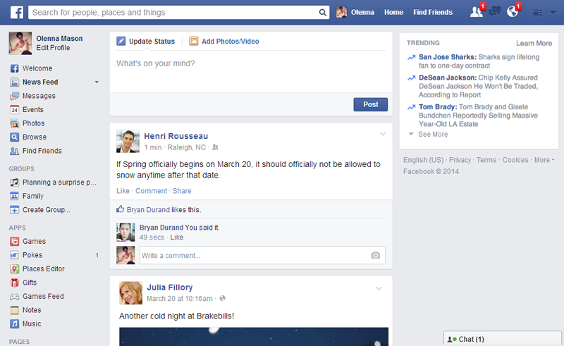
What is a web app?
Facebook: Facebook lets you create an online profile and interact with your friends. Profiles and conversations can be updated at any time, so Facebook uses web app technologies to keep the information up to date.

Slide 25
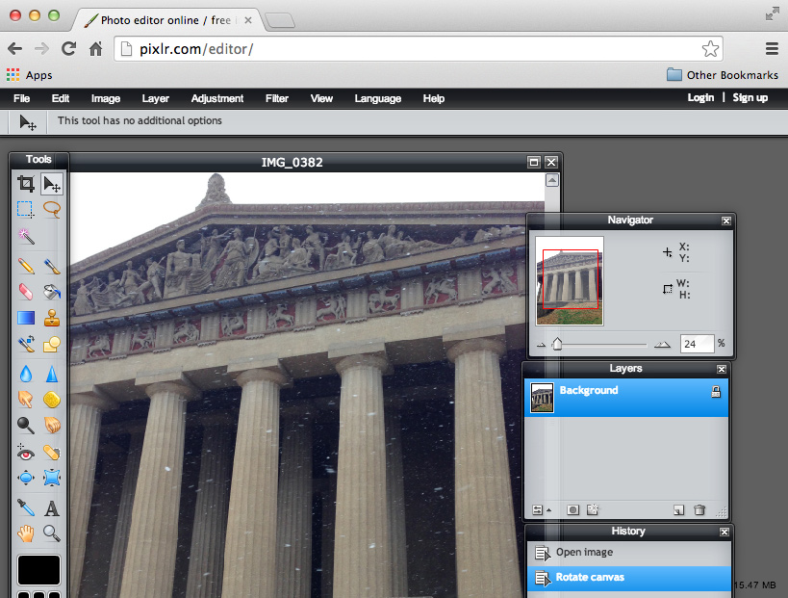
What is a web app?
Pixlr: Pixlr is an image editing application that runs in your web browser. Much like Adobe Photoshop, it includes many advanced features, like color correction and sharpening tools.

Slide 26
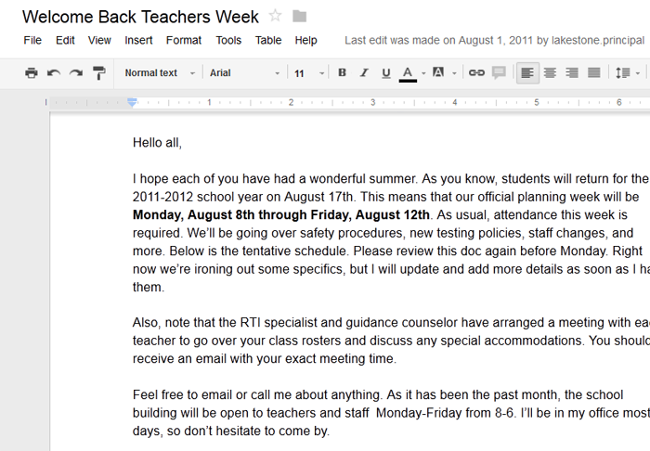
What is a web app?
Google Docs: Google Docs is an office suite that runs in your browser. Much like Microsoft Office, you can use it to create documents, spreadsheets, presentations, and more. And because the files are stored in the cloud, it's easy to share them with others.

Slide 27
THE END

