Slide 1
Computer Basics
Chapter 4 – Using a Computer

Slide 2
Contents
Setting Up a Computer
Getting Started with Your First Computer
Getting to Know the OS

Slide 3
Setting up a computer

Slide 4
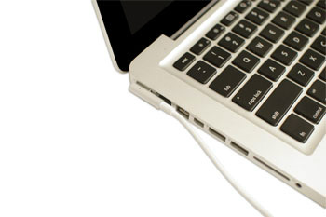
Setting up a laptop computer
If you have a laptop, setup should be easy: Just open it and press the power button. If the battery isn't charged, you'll need to plug in the AC adapter. You can continue using the laptop while it charges.

Slide 5
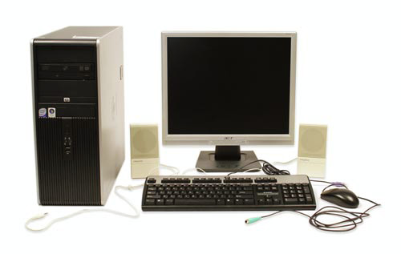
Setting up a desktop computer
Step 1
Unpack the monitor and computer case from the box. Remove any plastic covering or protective tape. Place the monitor and computer case on a desk or work area.
Be sure to place your computer case in an area that is well ventilated and has good air flow. This will help to prevent the computer from overheating.

Slide 6
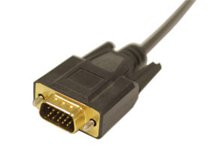
Setting up a desktop computer
Step 2
Locate the monitor cable. There are several types of monitor cables, so the one for your computer may not look like the one in the image below.
If you're having trouble finding your monitor cable, refer to the instruction manual for your computer. (If you have an all-in-one computer that's built into the monitor, you can skip to Step 4).

Slide 7
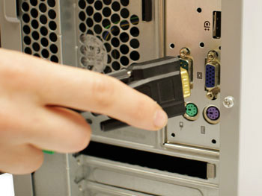
Setting up a desktop computer
Step 3
Connect one end of the cable to the monitor port on the back of the computer case and the other end to the monitor. If you're using a VGA cable like the one in the picture below, you'll want to tighten the screws on the monitor cable to secure it.

Slide 8
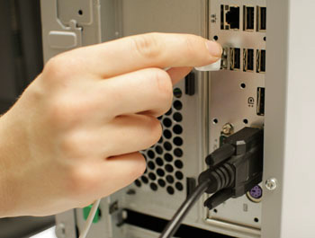
Setting up a desktop computer
Step 4
Unpack the keyboard and determine whether it uses a USB (rectangular) connector or a PS/2 (round) connector. If it uses a USB connector, plug it into any of the USB ports on the back of the computer. If it uses a PS/2 connector, plug it into the purple keyboard port on the back of the computer.

Slide 9
Setting up a desktop computer
Step 5
Unpack the mouse and determine whether it uses a USB or PS/2 connector. If it uses a USB connector, plug it into any of the USB ports on the back of the computer. If it uses a PS/2 connector, plug it into the green mouse port on the back of the computer.
*If your keyboard has a USB port, you can connect your mouse to the keyboard instead of connecting it directly to your computer.
*If you have a wireless mouse or keyboard, you may need to connect a Bluetooth dongle (USB adapter) to your computer. However, many computers have built-in Bluetooth, so an adapter may not be necessary.

Slide 10
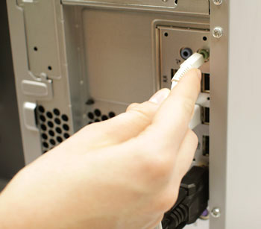
Setting up a desktop computer
Step 6
If you have external speakers or headphones, you can connect them to your computer's audio port (either on the front or back of the computer case). Many computers have color-coded ports. Speakers or headphones connect to the green port, and microphones connect to the pink port. The blue port is the line in, which can be used with other types of devices.
*Some speakers, headphones, and microphones have USB connectors instead of the usual audio plug. These can be connected to any USB port. In addition, many computers have speakers or microphones built into the monitor.

Slide 11
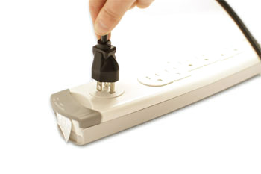
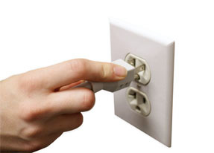
Setting up a desktop computer
Step 7
Locate the two power supply cables that came with your computer. Plug the first power supply cable into the back of the computer case and then into a surge protector. Then, using the other cable, connect the monitor to the surge protector. Finally, plug the surge protector into a wall outlet. You may also need to turn on the surge protector if it has a power switch.
*You can also use an uninterruptable power supply (UPS), which acts as a surge protector and provides temporary power if there is a power outage.

Slide 12
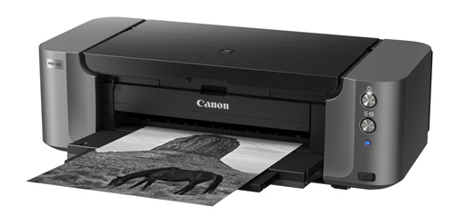
Setting up a desktop computer
Step 8
If you have a printer, scanner, webcam, or other peripherals, you can connect them at this point. Many peripherals are plug and play, which means they will be recognized by your computer as soon as they are plugged in.
Other peripherals may include software that needs to be installed before you can begin using them. Use the instructions included with the device to install it if necessary.

Slide 13
Getting to know your computer's OS

Slide 14
Getting to know your computer's OS

Slide 15
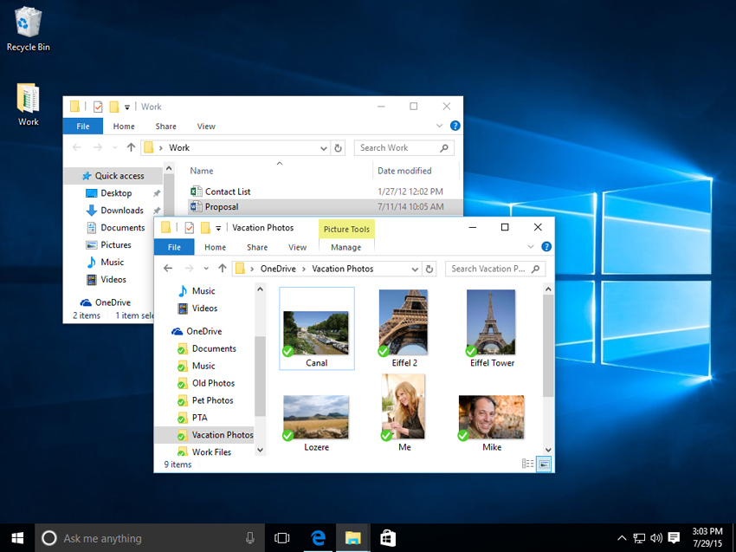
Getting to know the interface

Slide 16
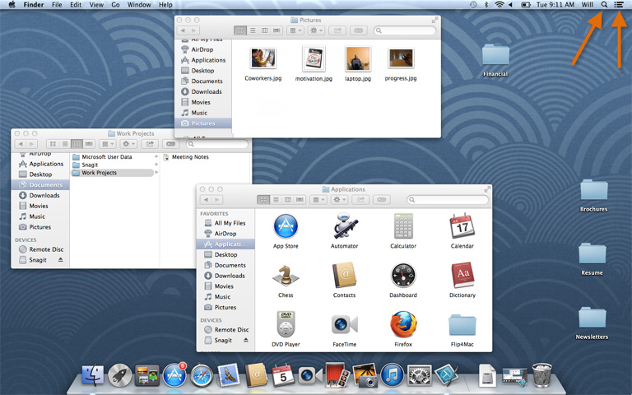
Getting to know the interface

Slide 17
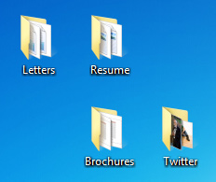
File system
No matter which operating system you use, your computer uses folders to organize all of the different files and applications it contains. Folder icons on your computer are designed to look like file folders full of documents or pictures.
Each operating system has its own file system, which helps you find your folders and files. If you have a Windows PC, you'll use the File Explorer (also known as Windows Explorer). If you have a Mac, you'll use Finder.

Slide 18
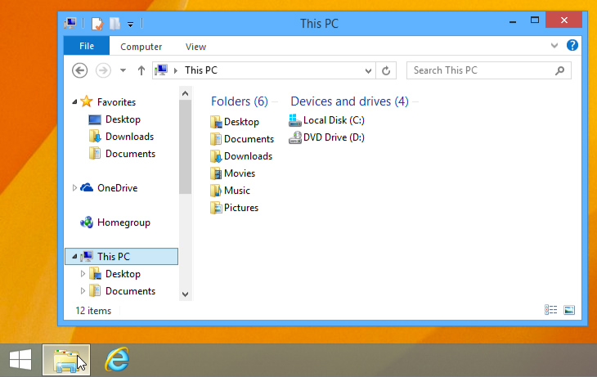
File system
Whether you're using a PC or a Mac, the file system icon will be in the bottom-left part of the screen. On a PC, the File Explorer icon looks like a folder, as in the image below.

Slide 19
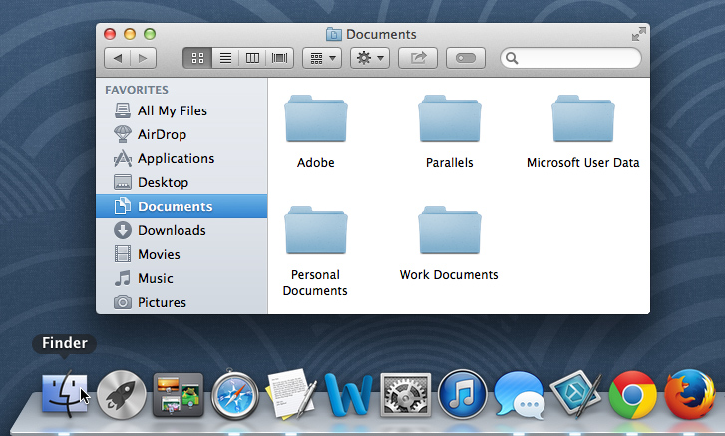
File system
On a Mac, the Finder icon looks like a face on the Dock, as in the image below.

Slide 20
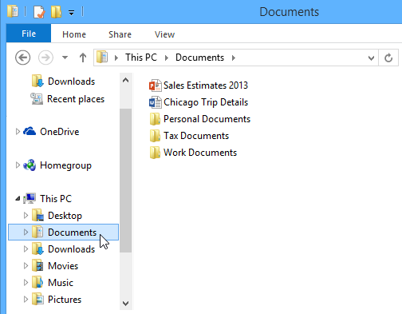
Basic navigation
Whether you're using Windows Explorer or Finder, basic navigation will work the same way. If you see the file you want, you can double-click it with your mouse. Otherwise, you can use the Navigation pane on the left side of the window to select a different location.

Slide 21
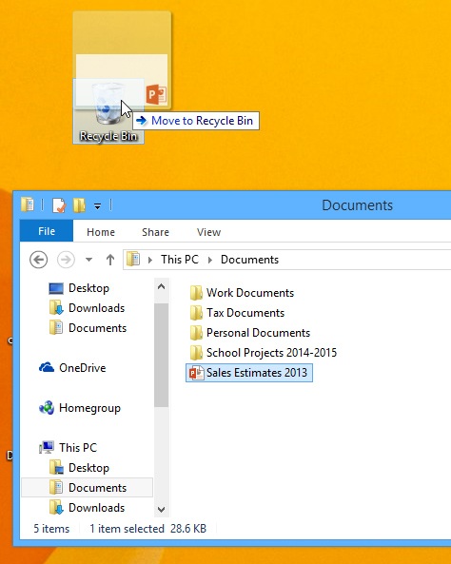
Deleting files
macOS and Windows use a Trash can—or Recycle Bin—to prevent you from accidentally deleting files. When you delete a file, it is moved to the Trash can. If you change your mind, you can move the file back to its original location.
If you want to permanently delete the file, you will need to empty the Trash or Recycle Bin. To do this, right-click the icon and select Empty.

Slide 22
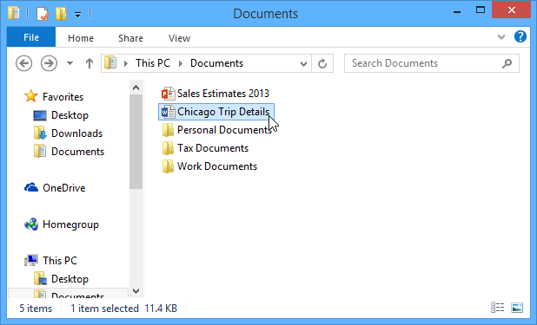
Opening files and applications
Each application on your computer has a group of file types—or formats—it is able to open. When you double-click a file, your computer will automatically use the correct application to open it. In our example, we're opening a Microsoft Word document (Chicago Trip Details), which will open in Microsoft Word.

Slide 23
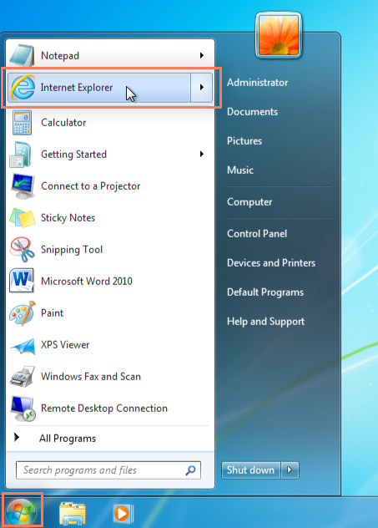
Opening files and applications
However, there may be times you may want to open an application directly, instead of just opening a file.
To open an application in Windows, click the Start button, then select the desired application. If you don't see the one you want, you can click All Programs/All Apps to see a full list, or simply type the name of the application on your keyboard to search for it. In the example below, we're opening Internet Explorer.

Slide 24
Opening files and applications
However, there may be times you may want to open an application directly, instead of just opening a file.
To open an application on a Mac, click the application's icon on the Dock. If you don't see the one you want, click the Spotlight icon in the top-right corner of the screen, then type the name of the application on your keyboard to search for it. In the example below, we're opening Safari.

Slide 25
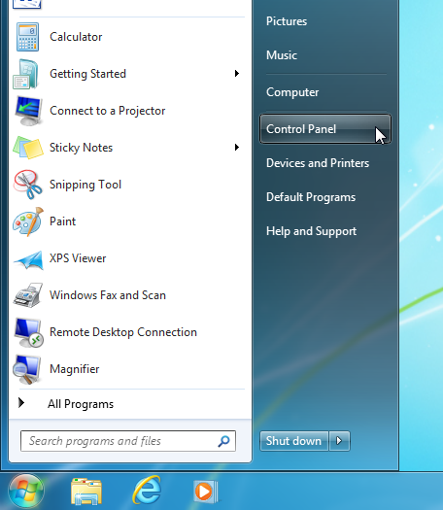
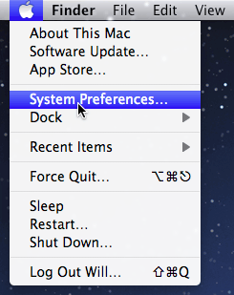
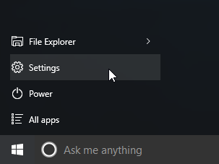
Adjusting your computer's settings
When you start using a new computer, you may want to begin by adjusting the computer's settings. Adjusting your settings can range from simple tasks such as changing your desktop background to more advanced tasks like adjusting your security or keyboard settings.
Windows 10
Windows 8.1 and earlier
Mac

Slide 26
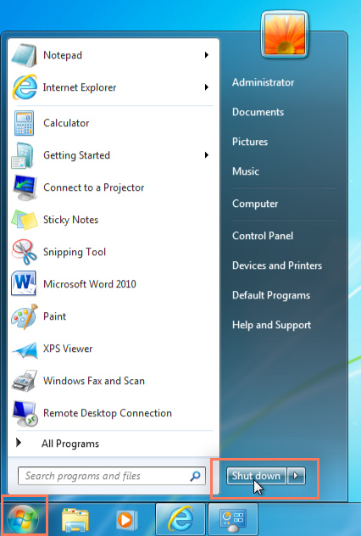
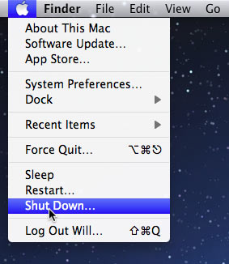
Shutting down your computer
To shut down Windows, click the Start button, then select Shut down (in some versions, this may say Turn Off Computer or look like the power symbol).
To shut down a Mac, click the Apple icon, then select Shut Down.

Slide 27
THE END

