Slide 1
ICT
Chapter 2 - Hardware Basics

Slide 2
Content
Basic Parts of a Computer
Buttons and Ports on a Computer
Inside a Computer
Laptop Computers
Mobile Devices

Slide 3
Basic Parts of a Computer

Slide 4
Hardware Basics
The basic parts of a desktop computer are the computer case, monitor, keyboard, mouse, and power card. Each part plays an important role whenever you use a computer.

Slide 5
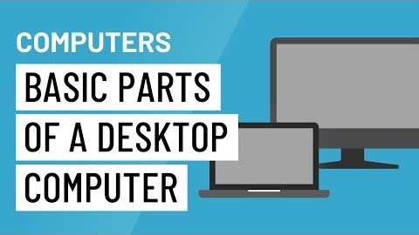
Hardware Basics

Slide 6
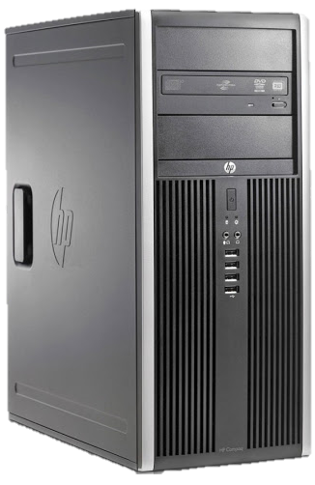
Computer case
The computer case is the metal and plastic box that contains the main components of the computer, including the motherboard, central processing unit (CPU), and power supply. The front of the case usually has an On/Off button and one or more optical drives.
Computer cases come in different shapes and sizes. A desktop case lies flat on a desk, and the monitor usually sits on top of it. A tower case is tall and sits next to the monitor or on the floor. All-in-one computers come with the internal components built into the monitor, which eliminates the need for a separate case.

Slide 7
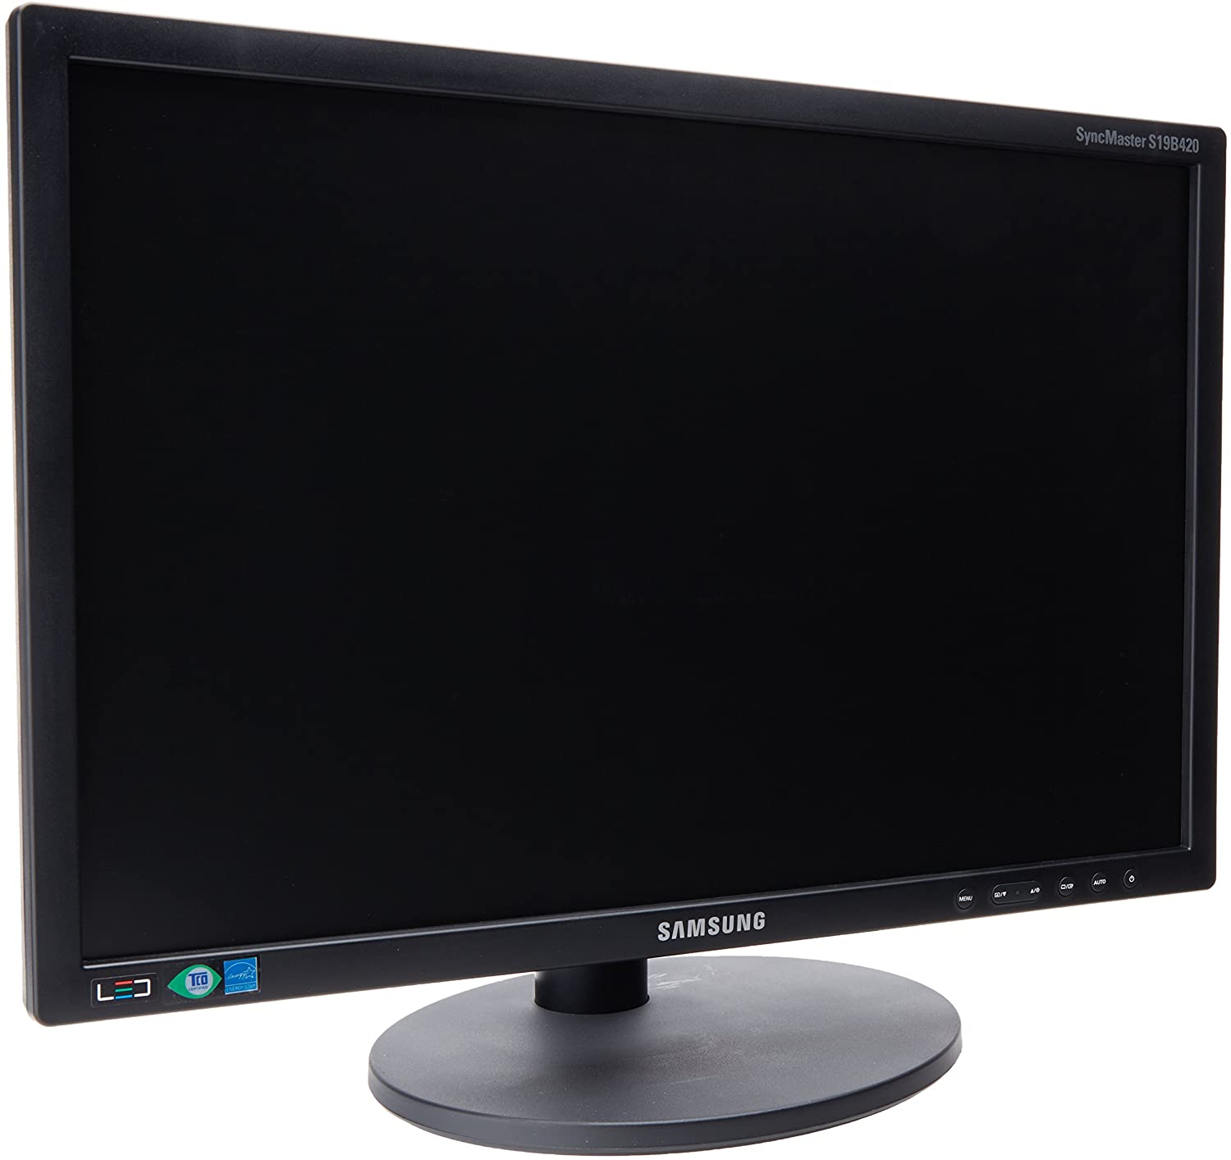
Monitor
The monitor works with a video card, located inside the computer case, to display images and text on the screen. Most monitors have control buttons that allow you to change your monitor's display settings, and some monitors also have built-in speakers.
Newer monitors usually have LCD (liquid crystal display) or LED (light-emitting diode) displays. These can be made very thin, and they are often called flat-panel displays. Older monitors use CRT (cathode ray tube) displays. CRT monitors are much larger and heavier, and they take up more desk space.

Slide 8
Keyboard
The keyboard is one of the main ways to communicate with a computer. There are many different types of keyboards, but most are very similar and allow you to accomplish the same basic tasks.

Slide 9
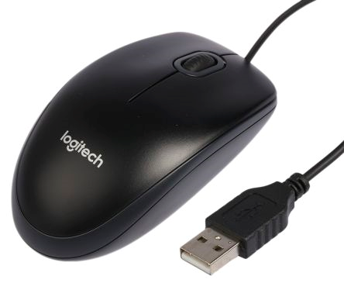
Mouse
There are two main mouse types: optical and mechanical. The optical mouse uses an electronic eye to detect movement and is easier to clean. The mechanical mouse uses a rolling ball to detect movement and requires regular cleaning to work properly.

Slide 10
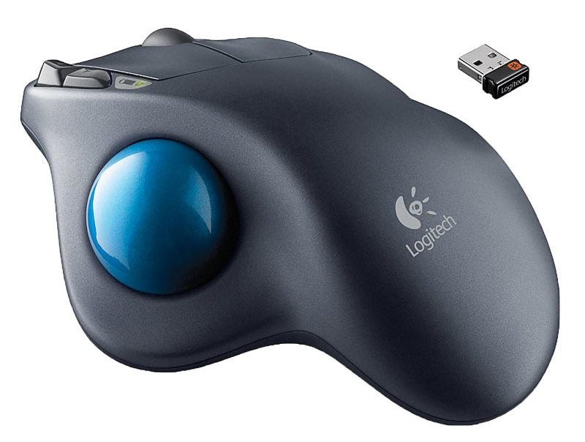
Mouse alternatives
Trackball: A trackball has a ball that can rotate freely. Instead of moving the device like a mouse, you can roll the ball with your thumb to move the pointer.

Slide 11
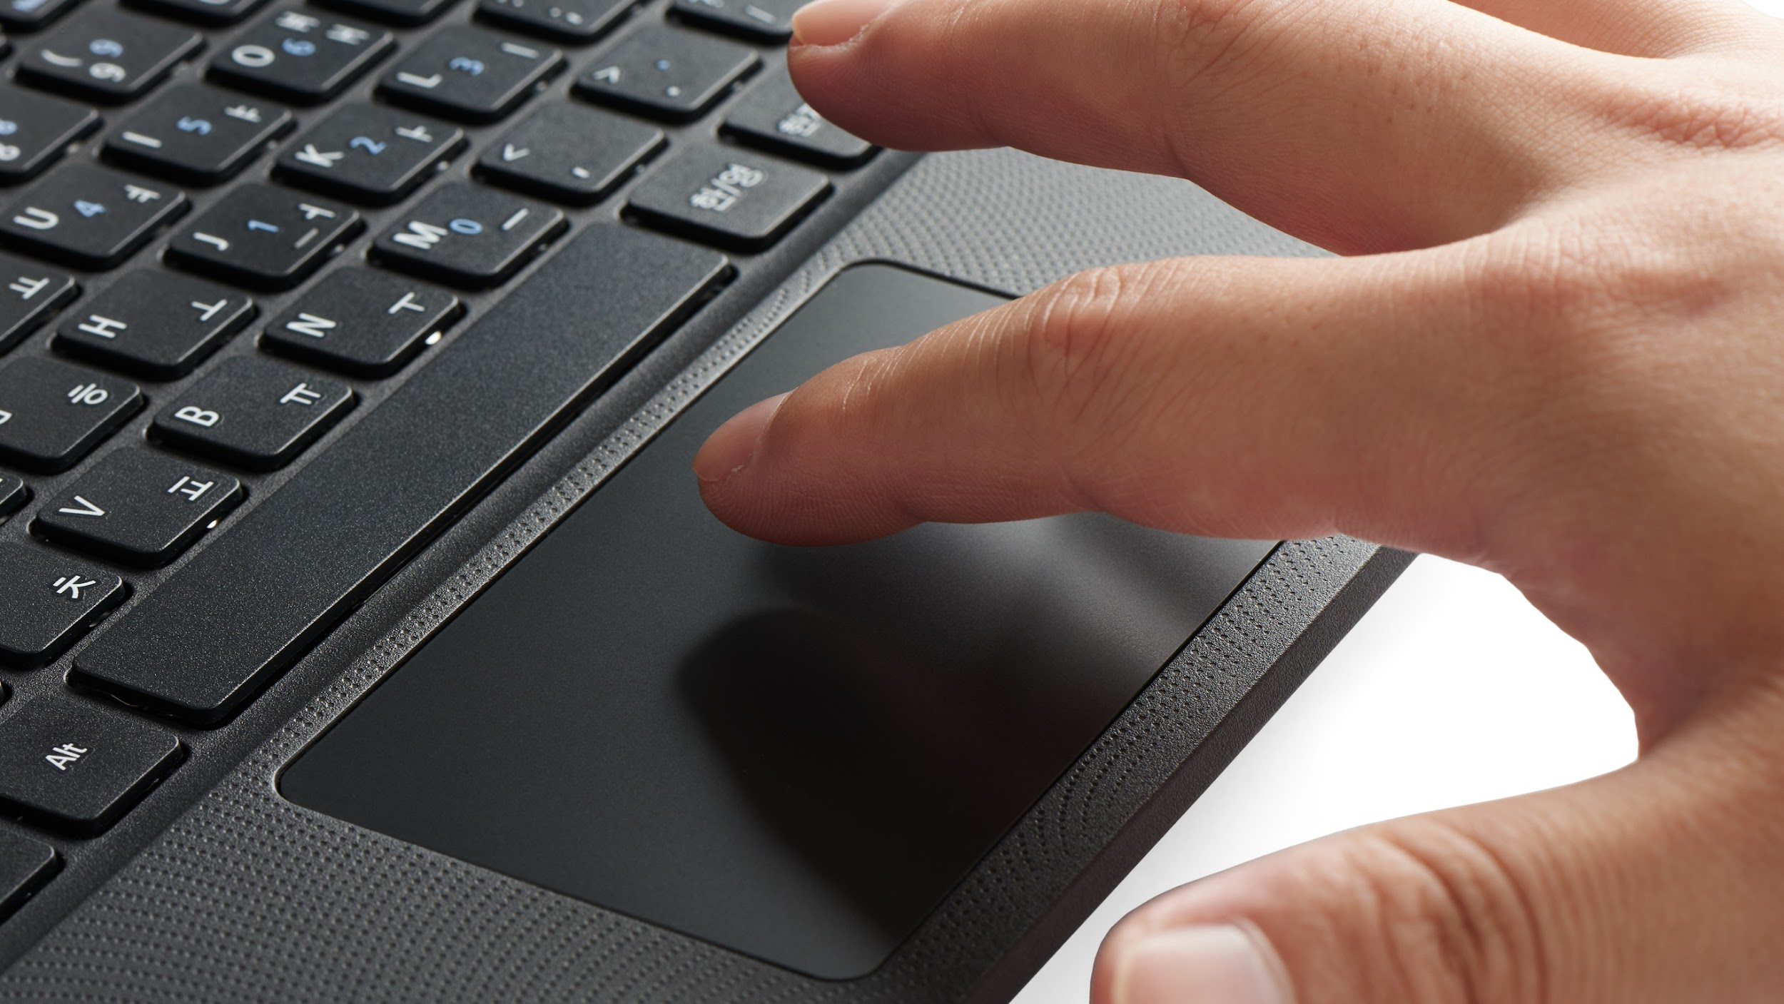
Mouse alternatives
Touchpad: A touchpad—also called a trackpad—is a touch-sensitive pad that lets you control the pointer by making a drawing motion with your finger. Touchpads are common on laptop computers.

Slide 12
Buttons and Ports on a Computer

Slide 13
Buttons and Ports on a Computer
Take a look at the front and back of your computer case and count the number of buttons, ports, and slots you see. Now look at your monitor and count any you find there. You probably counted at least 10, and maybe a lot more.
Each computer is different, so the buttons, ports, and sockets will vary from computer to computer. However, there are certain ones you can expect to find on most desktop computers. Learning how these ports are used will help whenever you need to connect something to your computer, like a new printer, keyboard, or mouse.

Slide 14
Buttons and Ports on a Computer

Slide 15
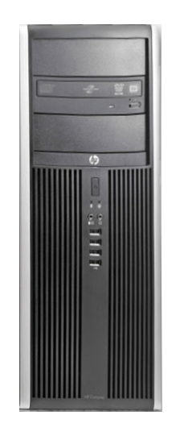
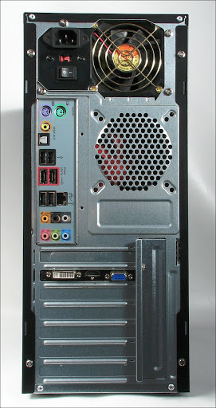
Computer case
The back of a computer case has connection ports that are made to fit specific devices. The placement will vary from computer to computer, and many companies have their own special connectors for specific devices. Some of the ports may be color coded to help you determine which port is used with a particular device.

Slide 16
Peripherals
The most basic computer setup usually includes the computer case, monitor, keyboard, and mouse, but you can plug many different types of devices into the extra ports on your computer. These devices are called peripherals. Let's take a look at some of the most common ones.

Slide 17
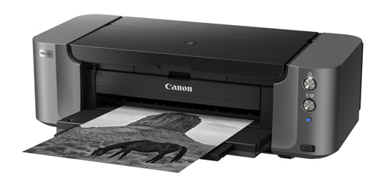
Printers
A printer is used to print documents, photos, and anything else that appears on your screen. There are many types of printers, including inkjet, laser, and photo printers. There are even all-in-one printers, which can also scan and copy documents.

Slide 18
Scanners
A scanner allows you to copy a physical image or document and save it to your computer as a digital (computer-readable) image. Many scanners are included as part of an all-in-one printer, although you can also buy a separate flatbed or handheld scanner.

Slide 19
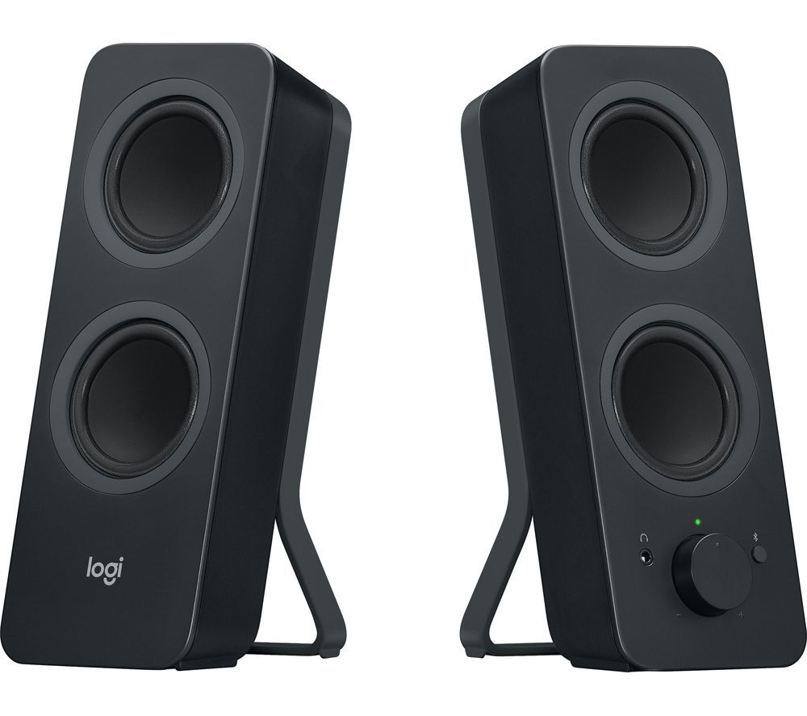
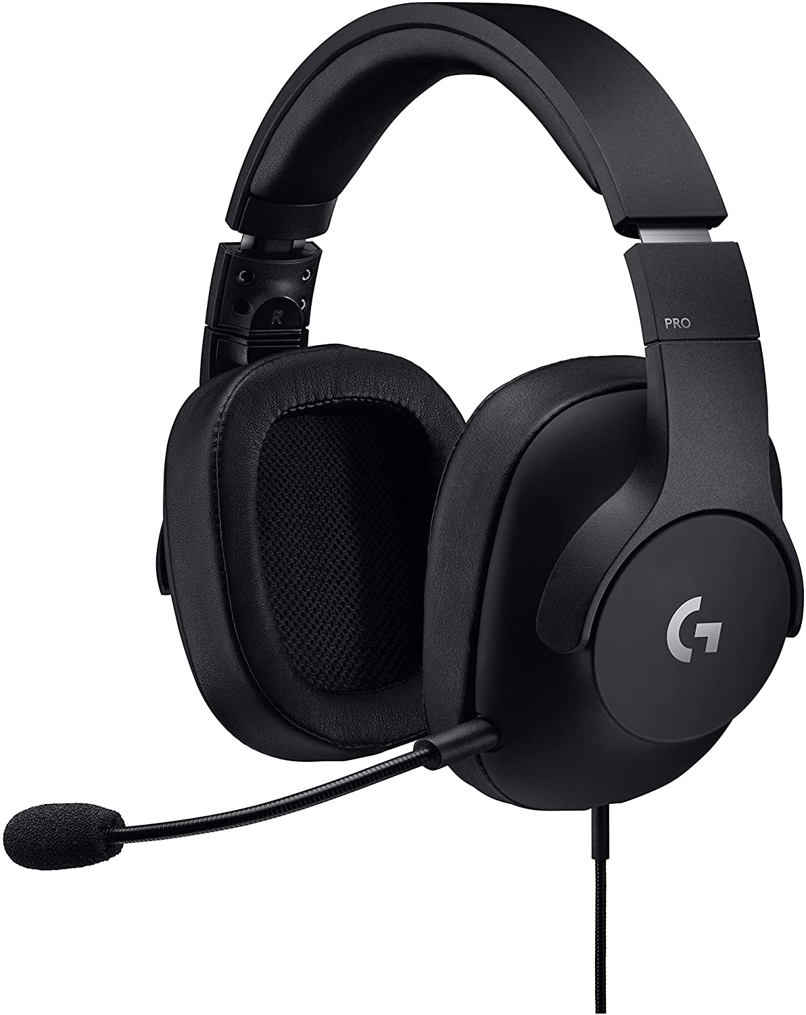
Speakers and Headphones
Speakers and headphones are output devices, which means they send information from the computer to the user—in this case, they allow you to hear sound and music. Depending on the model, they may connect to the audio port or the USB port. Some monitors also have built-in speakers.

Slide 20
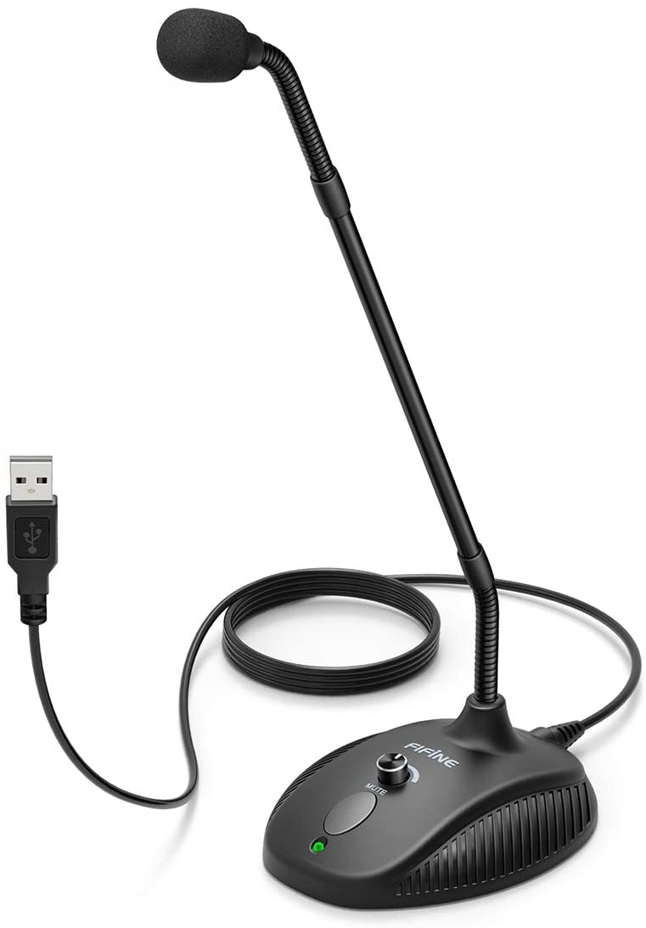
Microphones
A microphone is a type of input device, or a device that receives information from a user. You can connect a microphone to record sound or talk with someone else over the Internet. Many laptop computers come with built-in microphones.

Slide 21
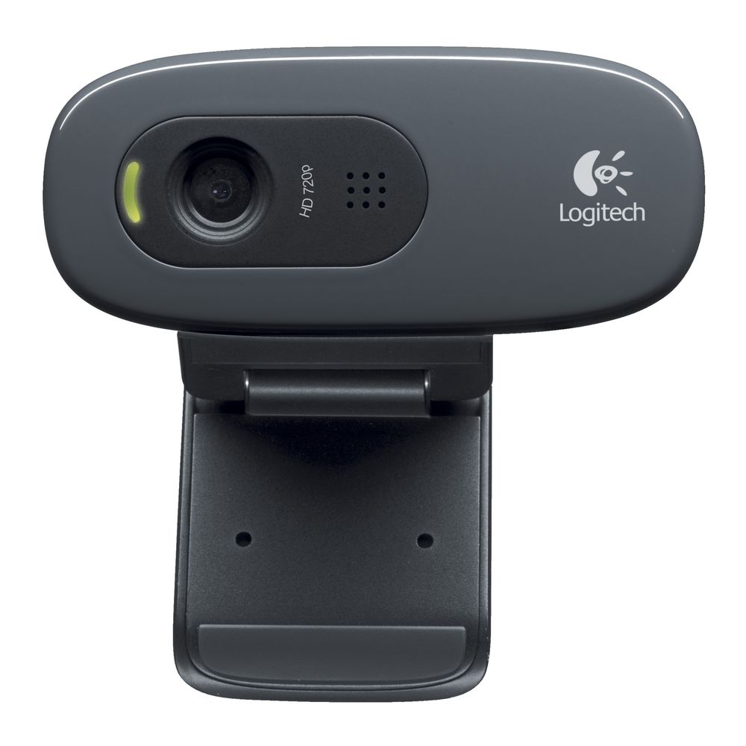
Web cameras
A web camera—or webcam—is a type of input device that can record videos and take pictures. It can also transmit video over the Internet in real time, which allows for video chat or video conferencing with someone else. Many webcams also include a microphone for this reason.

Slide 22
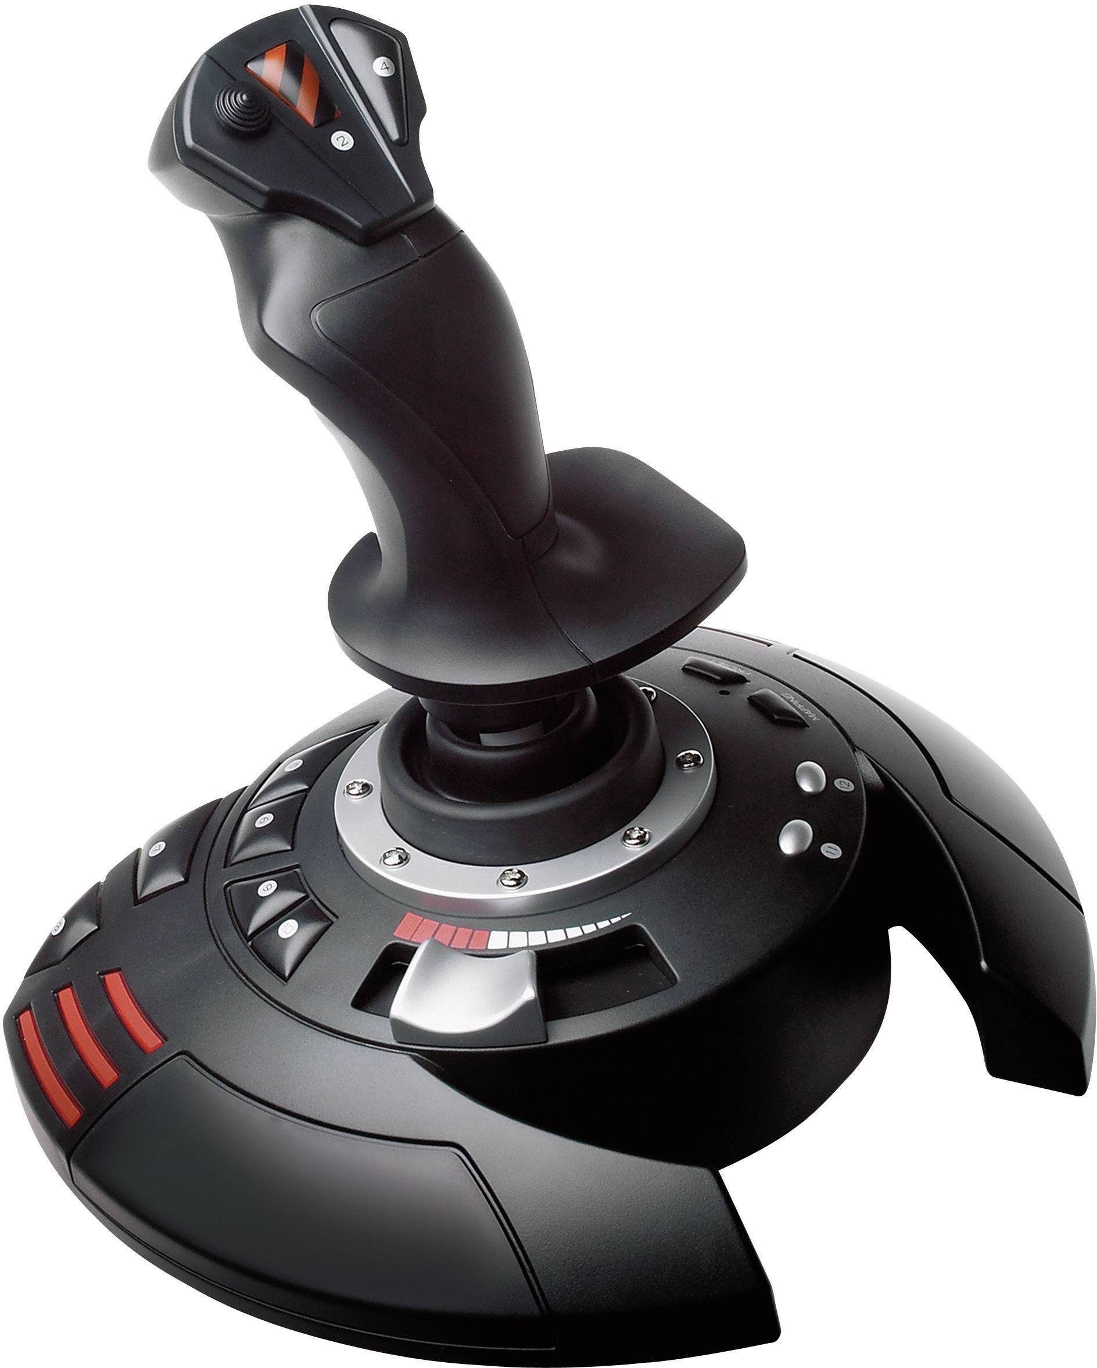
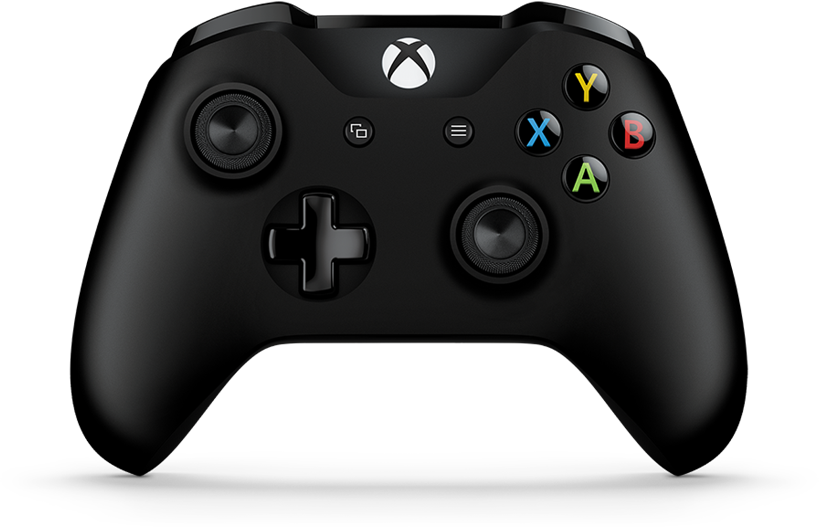
Game controllers and joysticks
Game controllers and joysticks: A game controller is used to control computer games. There are many other types of controllers you can use, including joysticks, although you can also use your mouse and keyboard to control most games.

Slide 23
Other devices
Digital cameras: A digital camera lets you capture pictures and videos in a digital format. By connecting the camera to your computer's USB port, you can transfer the images from the camera to the computer.
Mobile phones, MP3 players, tablet computers, and other devices: Whenever you buy an electronic device, such as a mobile phone or MP3 player, check to see if it comes with a USB cable. If it does, this means you can most likely connect it to your computer.

Slide 24
Inside a computer

Slide 25
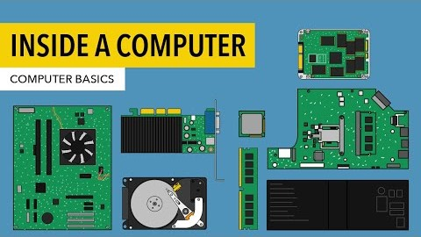
Inside a Computer

Slide 26
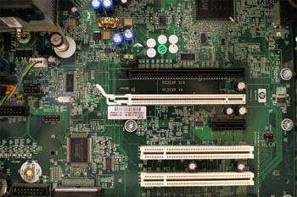
Motherboard
The motherboard is the computer's main circuit board. It's a thin plate that holds the CPU, memory, connectors for the hard drive and optical drives, expansion cards to control the video and audio, and connections to your computer's ports (such as USB ports). The motherboard connects directly or indirectly to every part of the computer.

Slide 27
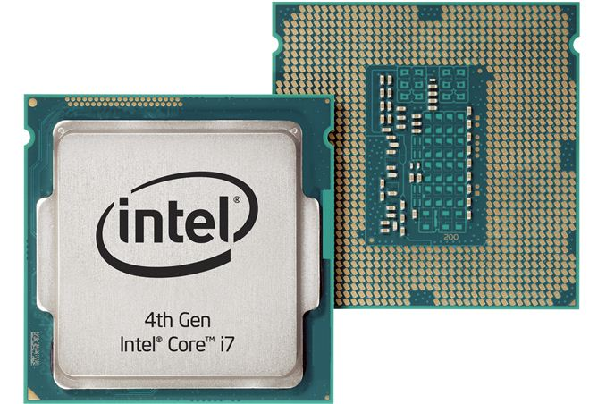
CPU / Processor
The central processing unit (CPU), also called a processor, is located inside the computer case on the motherboard. It is sometimes called the brain of the computer, and its job is to carry out commands. Whenever you press a key, click the mouse, or start an application, you're sending instructions to the CPU.

Slide 28
CPU / Processor
The CPU is usually a two-inch ceramic square with a silicon chip located inside. The chip is usually about the size of a thumbnail. The CPU fits into the motherboard’s CPU socket, which is covered by the heat sink, an object that absorbs heat from the CPU.
A processor's speed is measured in megahertz (MHz), or millions of instructions per second; and gigahertz (GHz), or billions of instructions per second. A faster processor can execute instructions more quickly. However, the actual speed of the computer depends on the speed of many different components—not just the processor.

Slide 29
RAM (random access memory)
RAM is your system's short-term memory. Whenever your computer performs calculations, it temporarily stores the data in the RAM until it is needed.

Slide 30
RAM (random access memory)
This short-term memory disappears when the computer is turned off. If you're working on a document, spreadsheet, or other type of file, you'll need to save it to avoid losing it. When you save a file, the data is written to the hard drive, which acts as long-term storage.
RAM is measured in megabytes (MB) or gigabytes (GB). The more RAM you have, the more things your computer can do at the same time. If you don't have enough RAM, you may notice that your computer is sluggish when you have several programs open. Because of this, many people add extra RAM to their computers to improve performance.

Slide 31
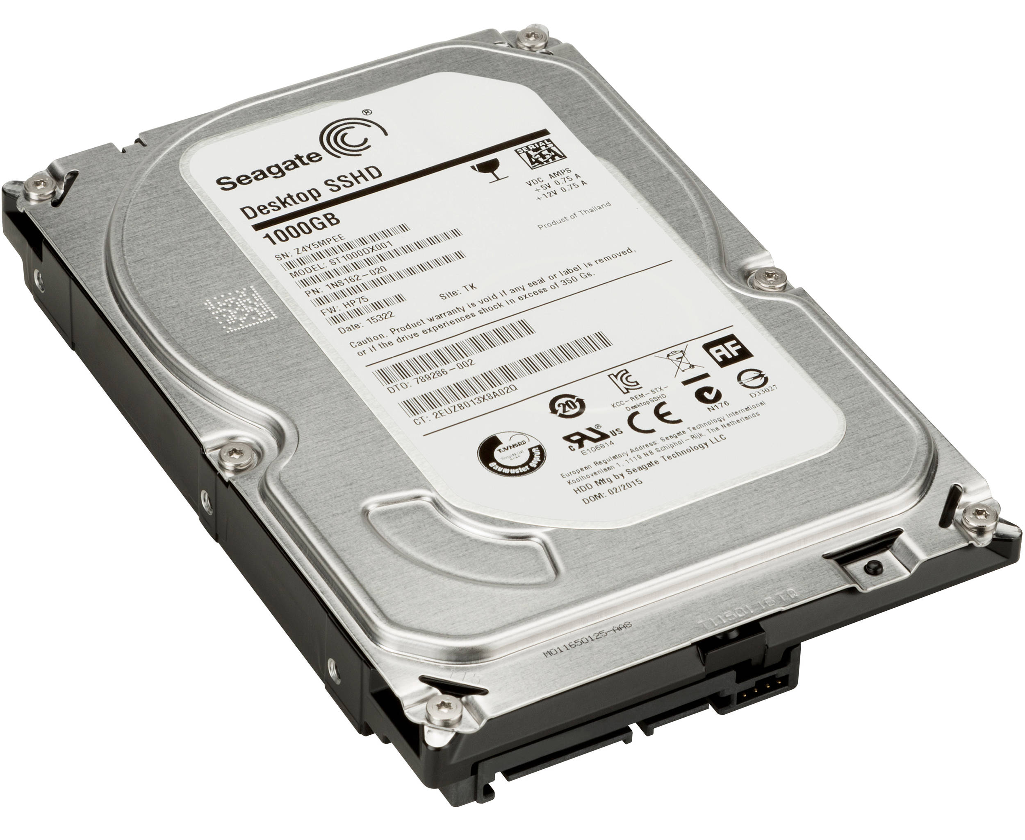
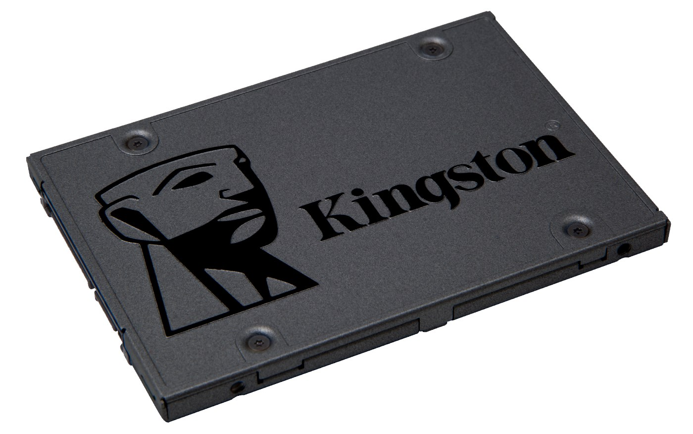
Hard drive
The hard drive is where your software, documents, and other files are stored. The hard drive is long-term storage, which means the data is still saved even if you turn the computer off or unplug it.
When you run a program or open a file, the computer copies some of the data from the hard drive onto the RAM. When you save a file, the data is copied back to the hard drive. The faster the hard drive, the faster your computer can start up and load programs.

Slide 32
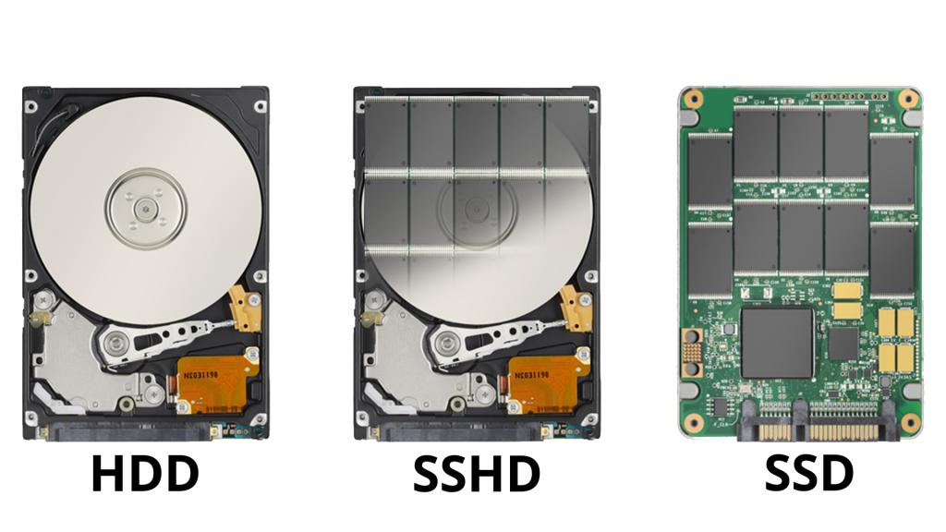
Hard drive: HDD
HDD (Hard Disk Drive) uses magnetic storage, spinning disks, and a moving actuator arm to write, retain and fetch digital information whenever needed. HDD consists of a mechanical arm that moves to read and write the data. This means that HDD performs physical movement to retrieve any required data.

Slide 33
Hard drive: SSD
SSD (Solid State Drive) is a storage drive made entirely of memory chips instead of the spinning magnetic platters you'd find inside a traditional hard disk. It's a bit like the storage in a USB thumb drive, but much faster.

Slide 34
Hard drive: SSHD
SSHD (Solid State Hybrid Drive) is a traditional spinning hard disk with a small amount of fast solid-state storage built in. SSHD is basically a hard drive and SSD in one, which is why it's called hybrid. The drive appears as a single device to Windows (or any other operating system), and the SSD part is just used for temporary storage to speed things up: your data is stored long-term on the mechanical disks.

Slide 35
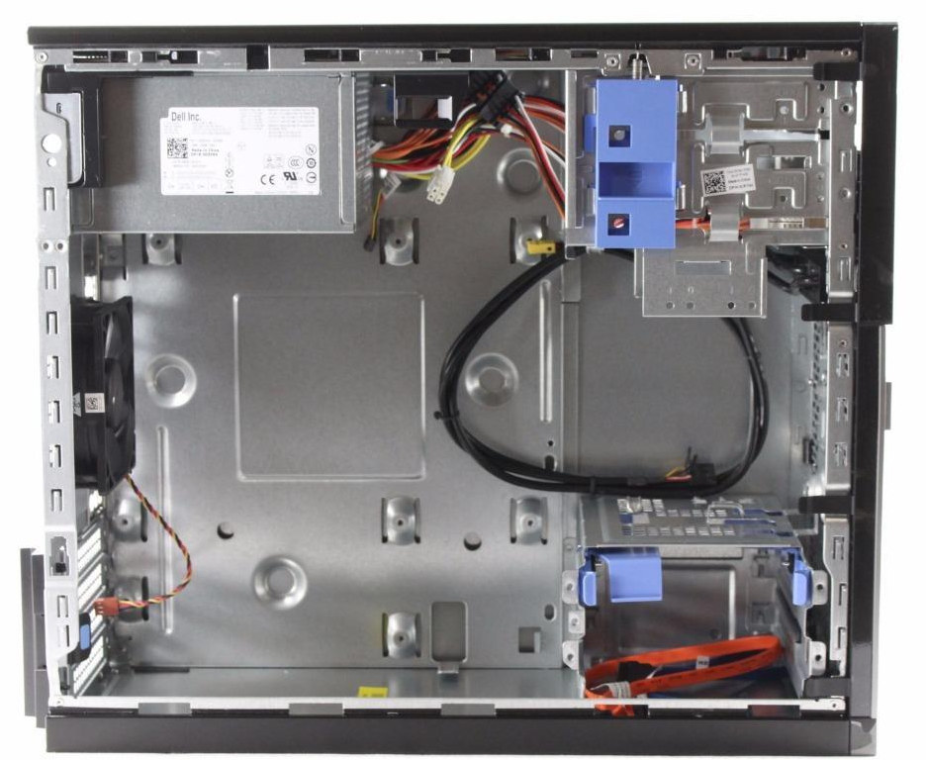
Power supply unit
The power supply unit in a computer converts the power from the wall outlet to the type of power needed by the computer. It sends power through cables to the motherboard and other components.

Slide 36
Expansion cards
Most computers have expansion slots on the motherboard that allow you to add various types of expansion cards. These are sometimes called PCI (peripheral component interconnect) cards. You may never need to add any PCI cards because most motherboards have built-in video, sound, network, and other capabilities.
However, if you want to boost the performance of your computer or update the capabilities of an older computer, you can always add one or more cards. Below are some of the most common types of expansion cards.

Slide 37
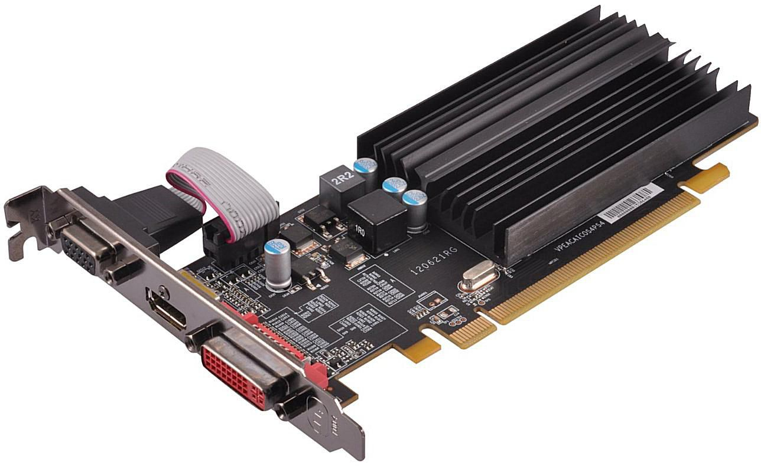
Expansion cards: Video card
The video card is responsible for what you see on the monitor. Most computers have a GPU (graphics processing unit) built into the motherboard instead of having a separate video card. If you like playing graphics-intensive games, you can add a faster video card to one of the expansion slots to get better performance.

Slide 38
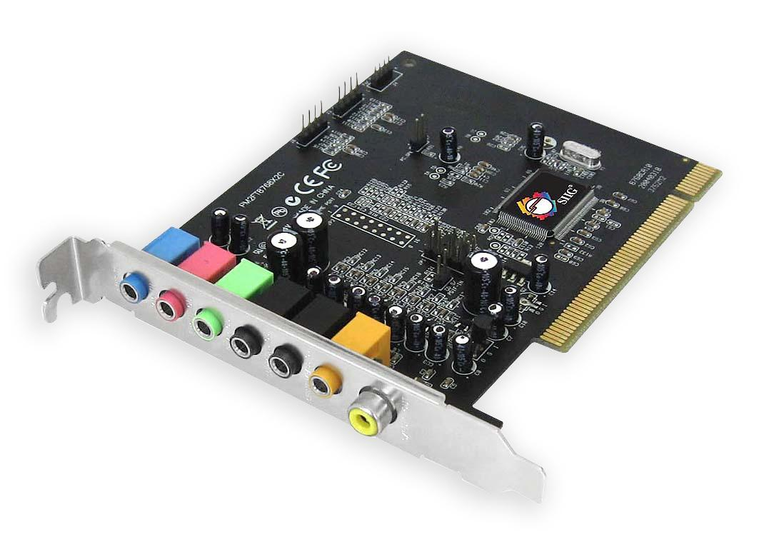
Expansion cards: Sound card
The sound card—also called an audio card—is responsible for what you hear in the speakers or headphones. Most motherboards have integrated sound, but you can upgrade to a dedicated sound card for higher-quality sound.

Slide 39
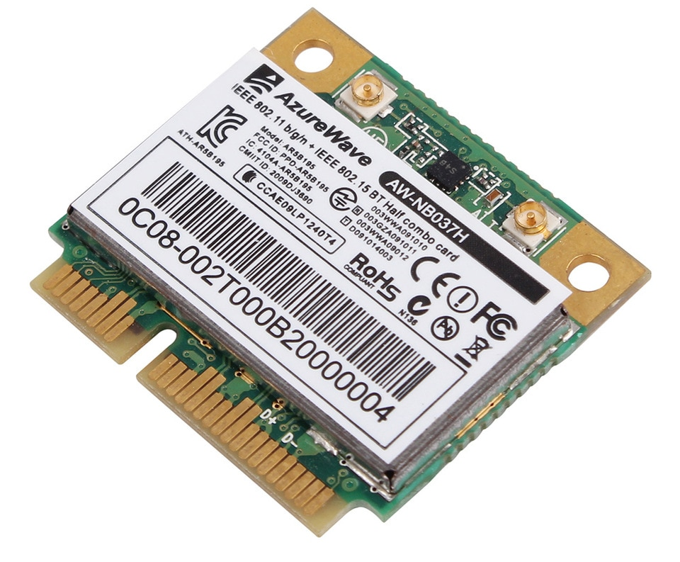
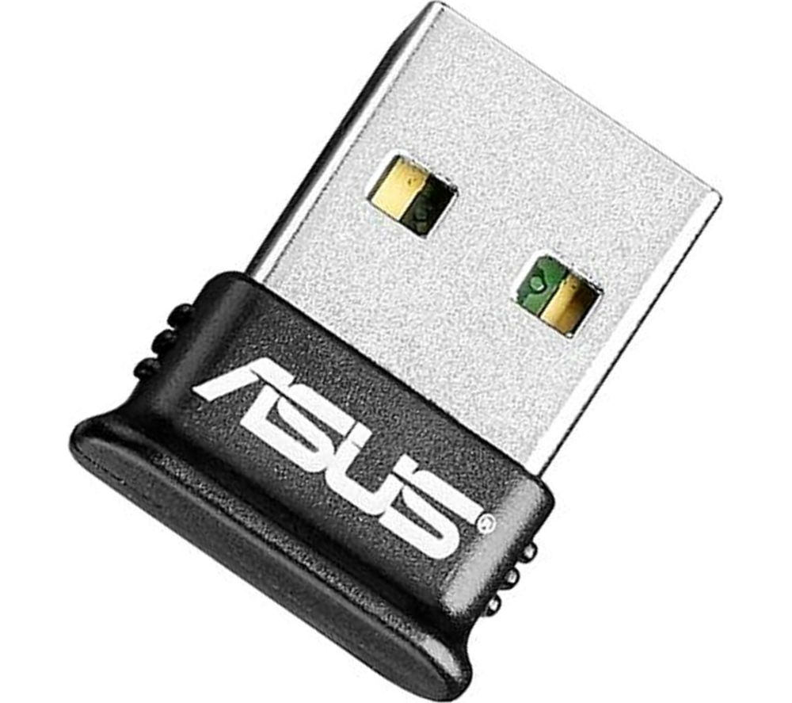
Expansion cards: Bluetooth card
Bluetooth is a technology for wireless communication over short distances. It's often used in computers to communicate with wireless keyboards, mice, and printers. It's commonly built into the motherboard or included in a wireless network card. For computers that don't have Bluetooth, you can purchase a USB adapter, often called a dongle.

Slide 40
Laptop computers

Slide 41
Laptop Computers
A laptop is a personal computer that can be easily moved and used in a variety of locations. Most laptops are designed to have all of the functionality of a desktop computer, which means they can generally run the same software and open the same types of files. However, laptops also tend to be more expensive than comparable desktop computers.

Slide 42
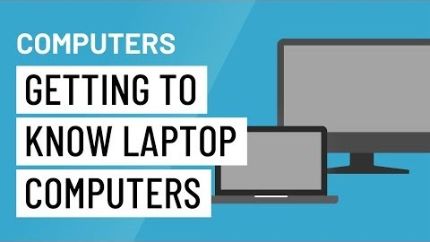
Laptop Computers

Slide 43
Laptop vs Desktop
Because laptops are designed for portability, there are some important differences between them and desktop computers. A laptop has an all-in-one design, with a built-in monitor, keyboard, touchpad (which replaces the mouse), and speakers. This means it is fully functional, even when no peripherals are connected. A laptop is also quicker to set up, and there are fewer cables to get in the way.
You'll also have to the option to connect a regular mouse, larger monitor, and other peripherals. This basically turns your laptop into a desktop computer, with one main difference: You can easily disconnect the peripherals and take the laptop with you wherever you go.

Slide 44
Laptop vs Desktop
Touchpad: A touchpad—also called a trackpad—is a touch-sensitive pad that lets you control the pointer by making a drawing motion with your finger.
Battery: Every laptop has a battery, which allows you to use the laptop when it's not plugged in. Whenever you plug in the laptop, the battery recharges. Another benefit of having a battery is that it can provide backup power to the laptop if the power goes out.
AC adapter: A laptop usually has a specialized power cable called an AC adapter, which is designed to be used with that specific type of laptop.
Ports: Most laptops have the same types of ports found on desktop computers (such as USB), although they usually have fewer ports to save space. However, some ports may be different, and you may need an adapter in order to use them.
Price: Generally speaking, laptops tend to be more expensive than a desktop computer with the same internal components. While you may find that some basic laptops cost less than desktop computers, these are usually much less powerful machines.

Slide 45
Mobile devices

Slide 46
Mobile devices
A mobile device is a general term for any type of handheld computer. These devices are designed to be extremely portable, and they can often fit in your hand. Some mobile devices—like tablets, e-readers, and smartphones—are powerful enough to do many of the same things you can do with a desktop or laptop computer.

Slide 47
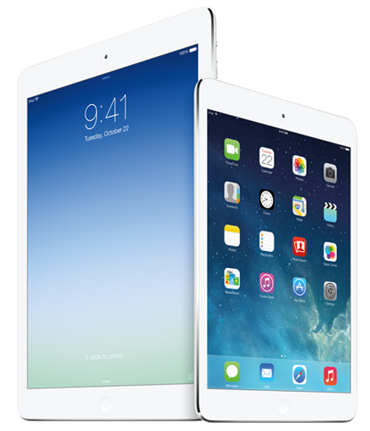
Tablet computers
Like laptops, tablet computers are designed to be portable. However, they provide a different computing experience. The most obvious difference is that tablet computers don't have keyboards or touchpads. Instead, the entire screen is touch-sensitive, allowing you to type on a virtual keyboard and use your finger as a mouse pointer.

Slide 48
Tablet computers
Tablet computers can't necessarily do everything traditional computers can do. For many people, a traditional computer like a desktop or laptop is still needed in order to use some programs. However, the convenience of a tablet computer means it may be ideal as a second computer.

Slide 49
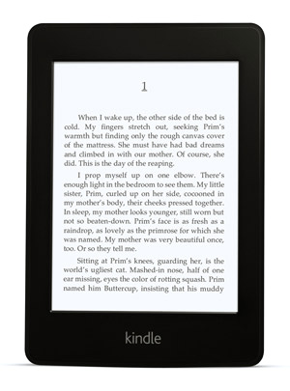
E-readers
E-book readers—also called e-readers—are similar to tablet computers, except they are mainly designed for reading e-books. Notable examples include the Amazon Kindle, Barnes & Noble Nook, and Kobo. Most e-readers use an e-ink display, which is easier to read than a traditional computer display. You can even read in bright sunlight, just like if you were reading a regular book.
You don't need an e-reader to read e-books. They can also be read on tablets, smartphones, laptops, and desktops.

Slide 50
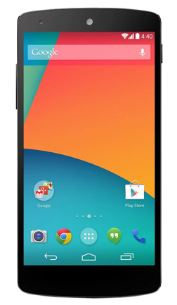
Smartphones
A smartphone is a more powerful version of a traditional cell phone. In addition to the same basic features—phone calls, voicemail, text messaging—smartphones can connect to the Internet over Wi-Fi or a cellular network. This means you can use a smartphone for the same things you would normally do on a computer, such as checking your email, browsing the Web, or shopping online.

Slide 51
THE END

